Slide 1
Loving vs. Virginia
Interracial marriage
By Damon Wood

Slide 2
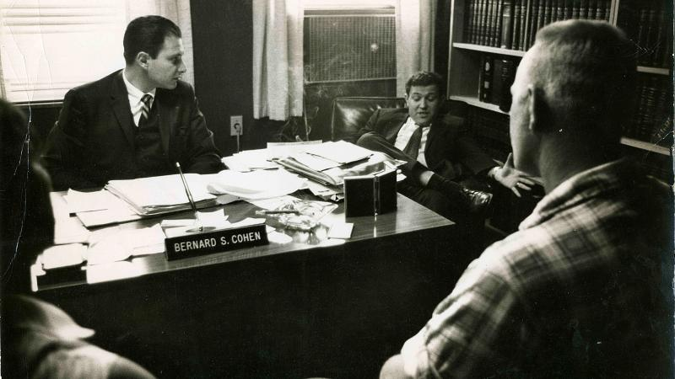
Dates of the case
in 1958 they were sentenced to a year in prison for marrying each other.
June 12, 1967, the Court issued a unanimous decision in the Lovings' favor and overturned their convictions.

Slide 3
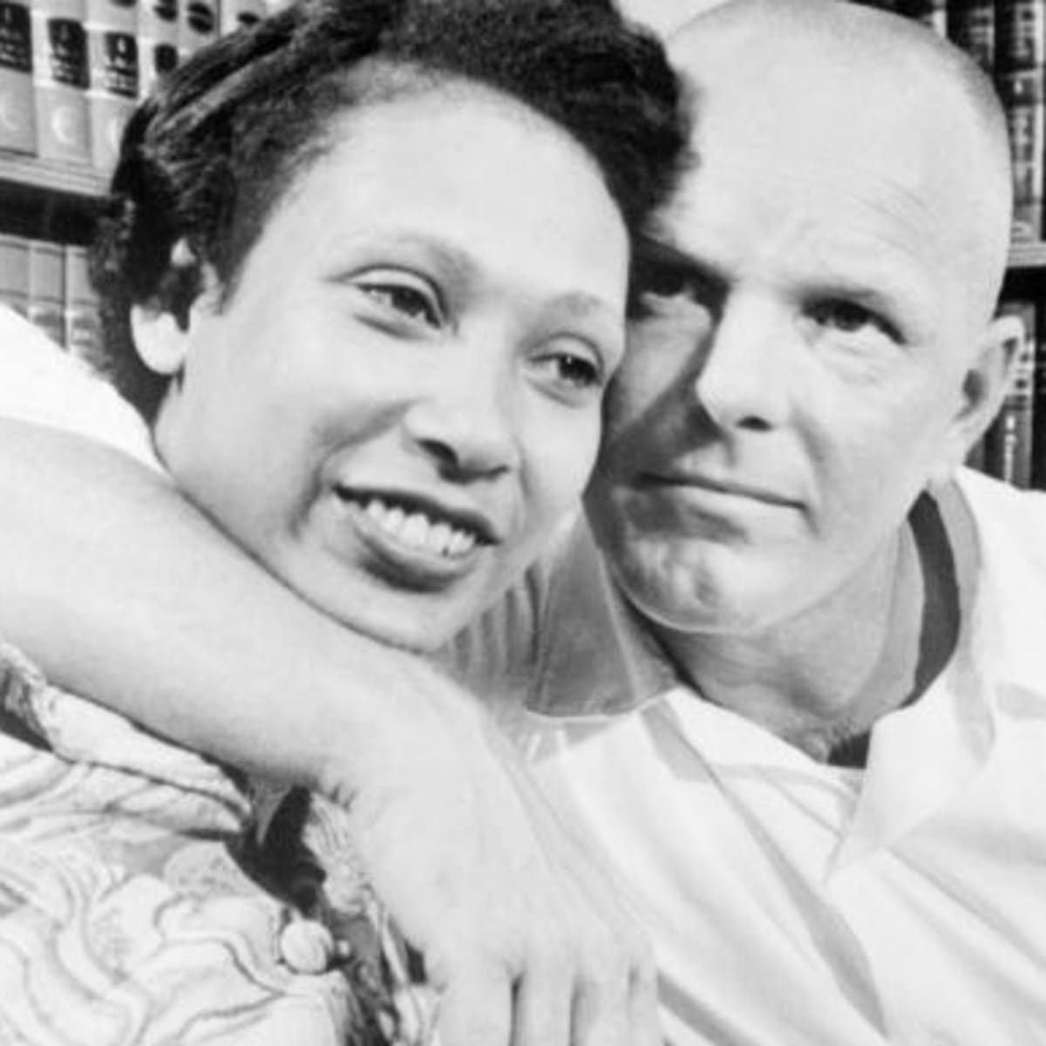
background info
The case involved Mildred Loving, a woman of color, and her white husband Richard Loving, who in 1958 were sentenced to a year in prison for marrying each other. Their marriage violated Virginia's Racial Integrity Act of 1924, which criminalized marriage between people classified as "white" and people classified as "colored".
https://en.wikipedia.org/wiki/Loving_v._Virginia

Slide 4
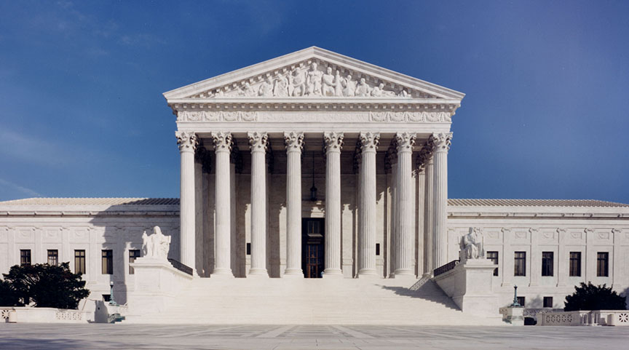
Main case facts
Mildred and Richard loving got arrested for interracial marriage in Virginia.
They were sentenced to a year in prison for said crime
They tried to appeal the eviction at the supreme court of Virginia but they would not allow it
They gained enough attention to try and appeal their eviction at the US Supreme court and they allowed it.
The us supreme court overturned the Loving’s conviction.

Slide 5
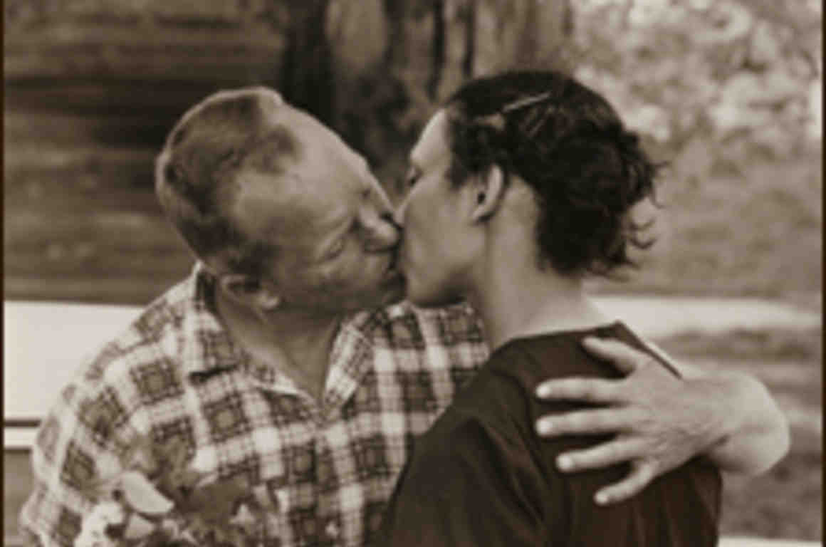
Outcome of the case
Richard and Mildred loving’s conviction of interracial marriage in the state of Virginia was overturned by the US Supreme Court by unanimous decision.

